Slide 1
BYODD @ OHS 2019
The future of learning is now

Slide 2
Workshop Outline
The OHS Technology Journey
Digital skills and their place in learning today
School support – What is available? Who can I speak to?
BYODD Reference Guide – support your child at home
Sentral Parent & Student Portal
Devices for 2019
Parent Survey
BYODD – Q and A

Slide 3
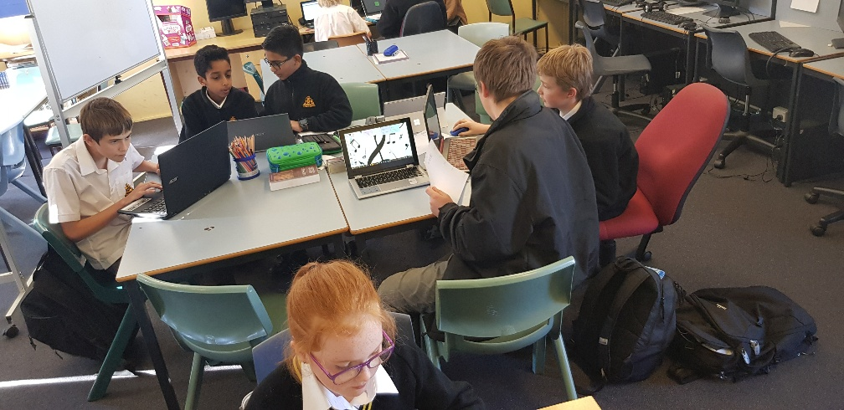
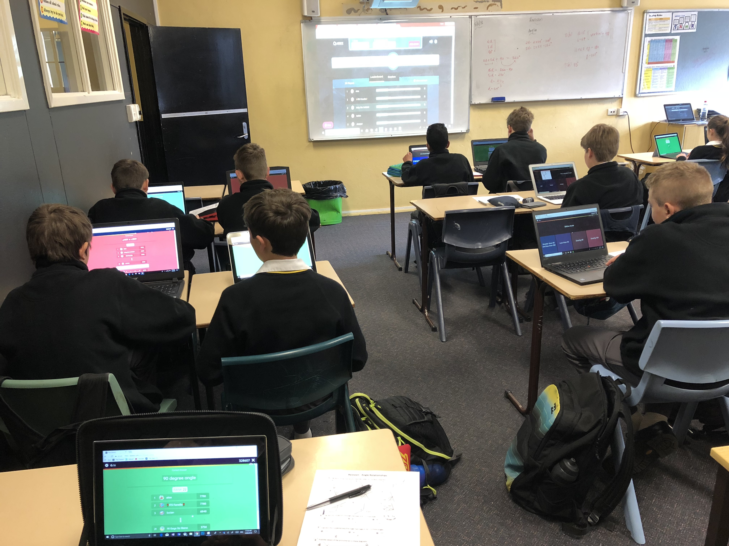
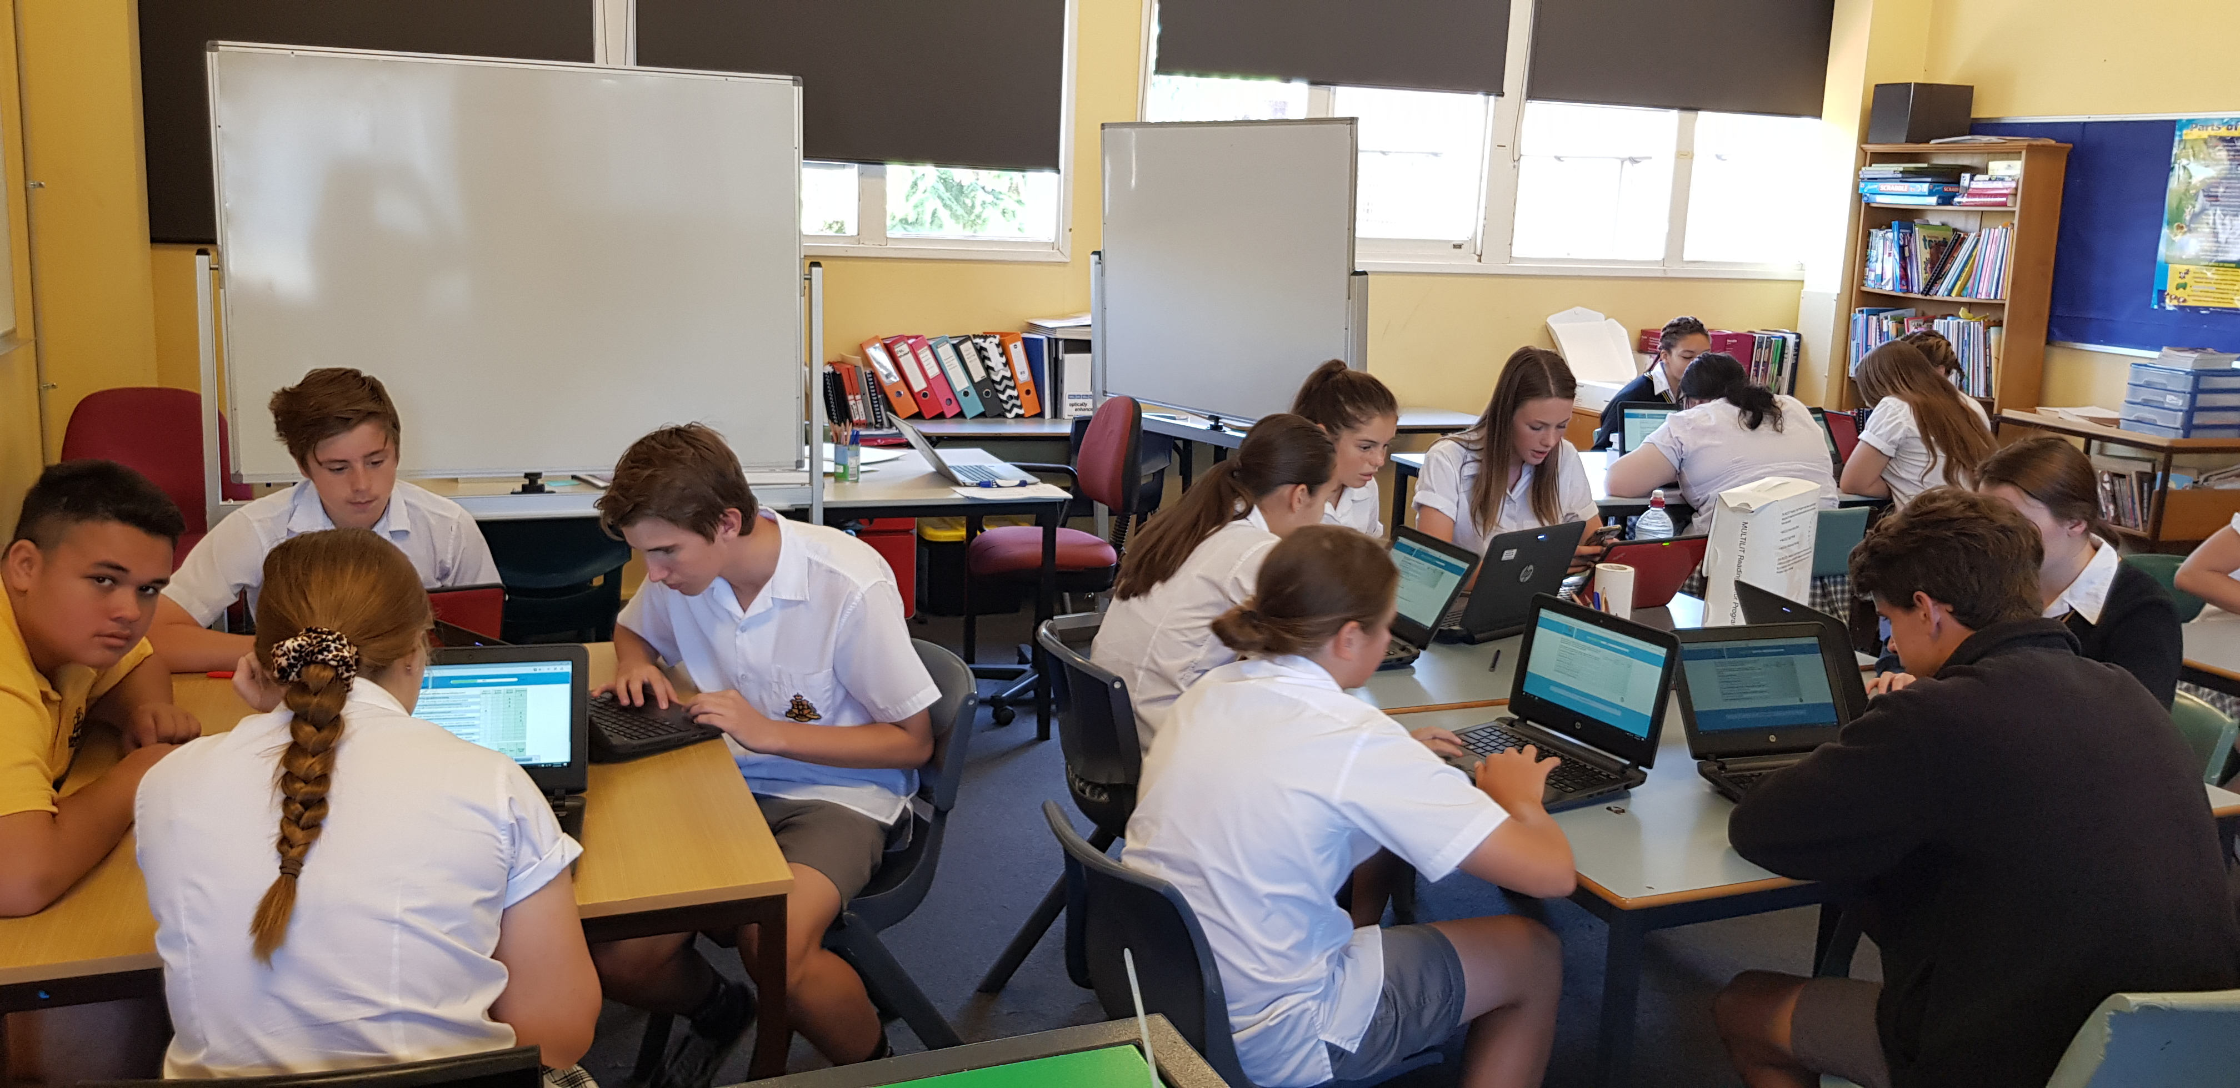
At Orange High School our aim is to provide each and every one of our students with essential 21st Century skills to support them at school and beyond.

Slide 4
Why are digital skills so important?
Since 2013 the demand for digital skills has
increased by more than 200%
(Foundation for Young Australians, 2016)

Slide 5
So what are these 21st century skills?

Slide 6
What are the skills our students will need?
The Australian Curriculum suggests that "students need to develop a set of knowledge, skills, behaviour and disposition, or general capabilities that apply across the learning area content and equip them to be lifelong learners able to operate with confidence in a complex, information-rich, globalised world".
(Source: https://www.australiancurriculum.edu.au/)

Slide 7
"Students live in a rapidly changing technological world. Information and communication technology (ICT), including hardware and personal digital devices, software, and systems that manage, store, process, create, produce and communicate information, has become an important part of everyday life”
(NSW Education Standards Authority, 2017, para. 1)

Slide 8
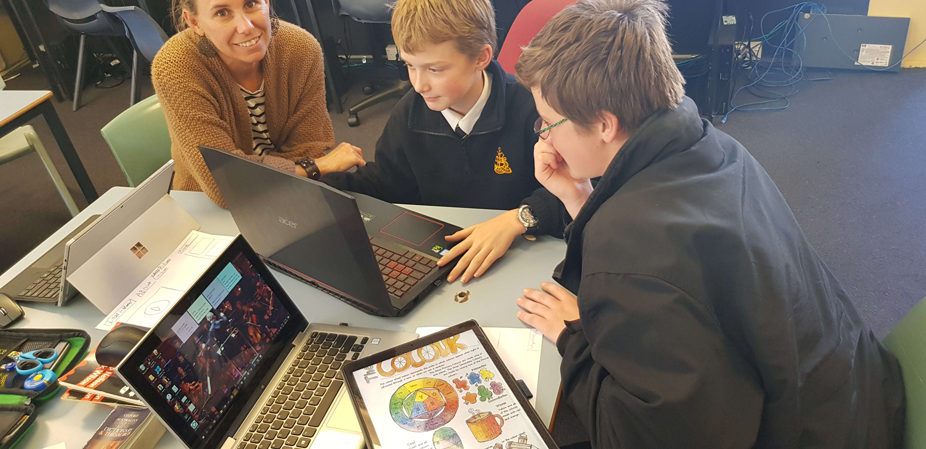
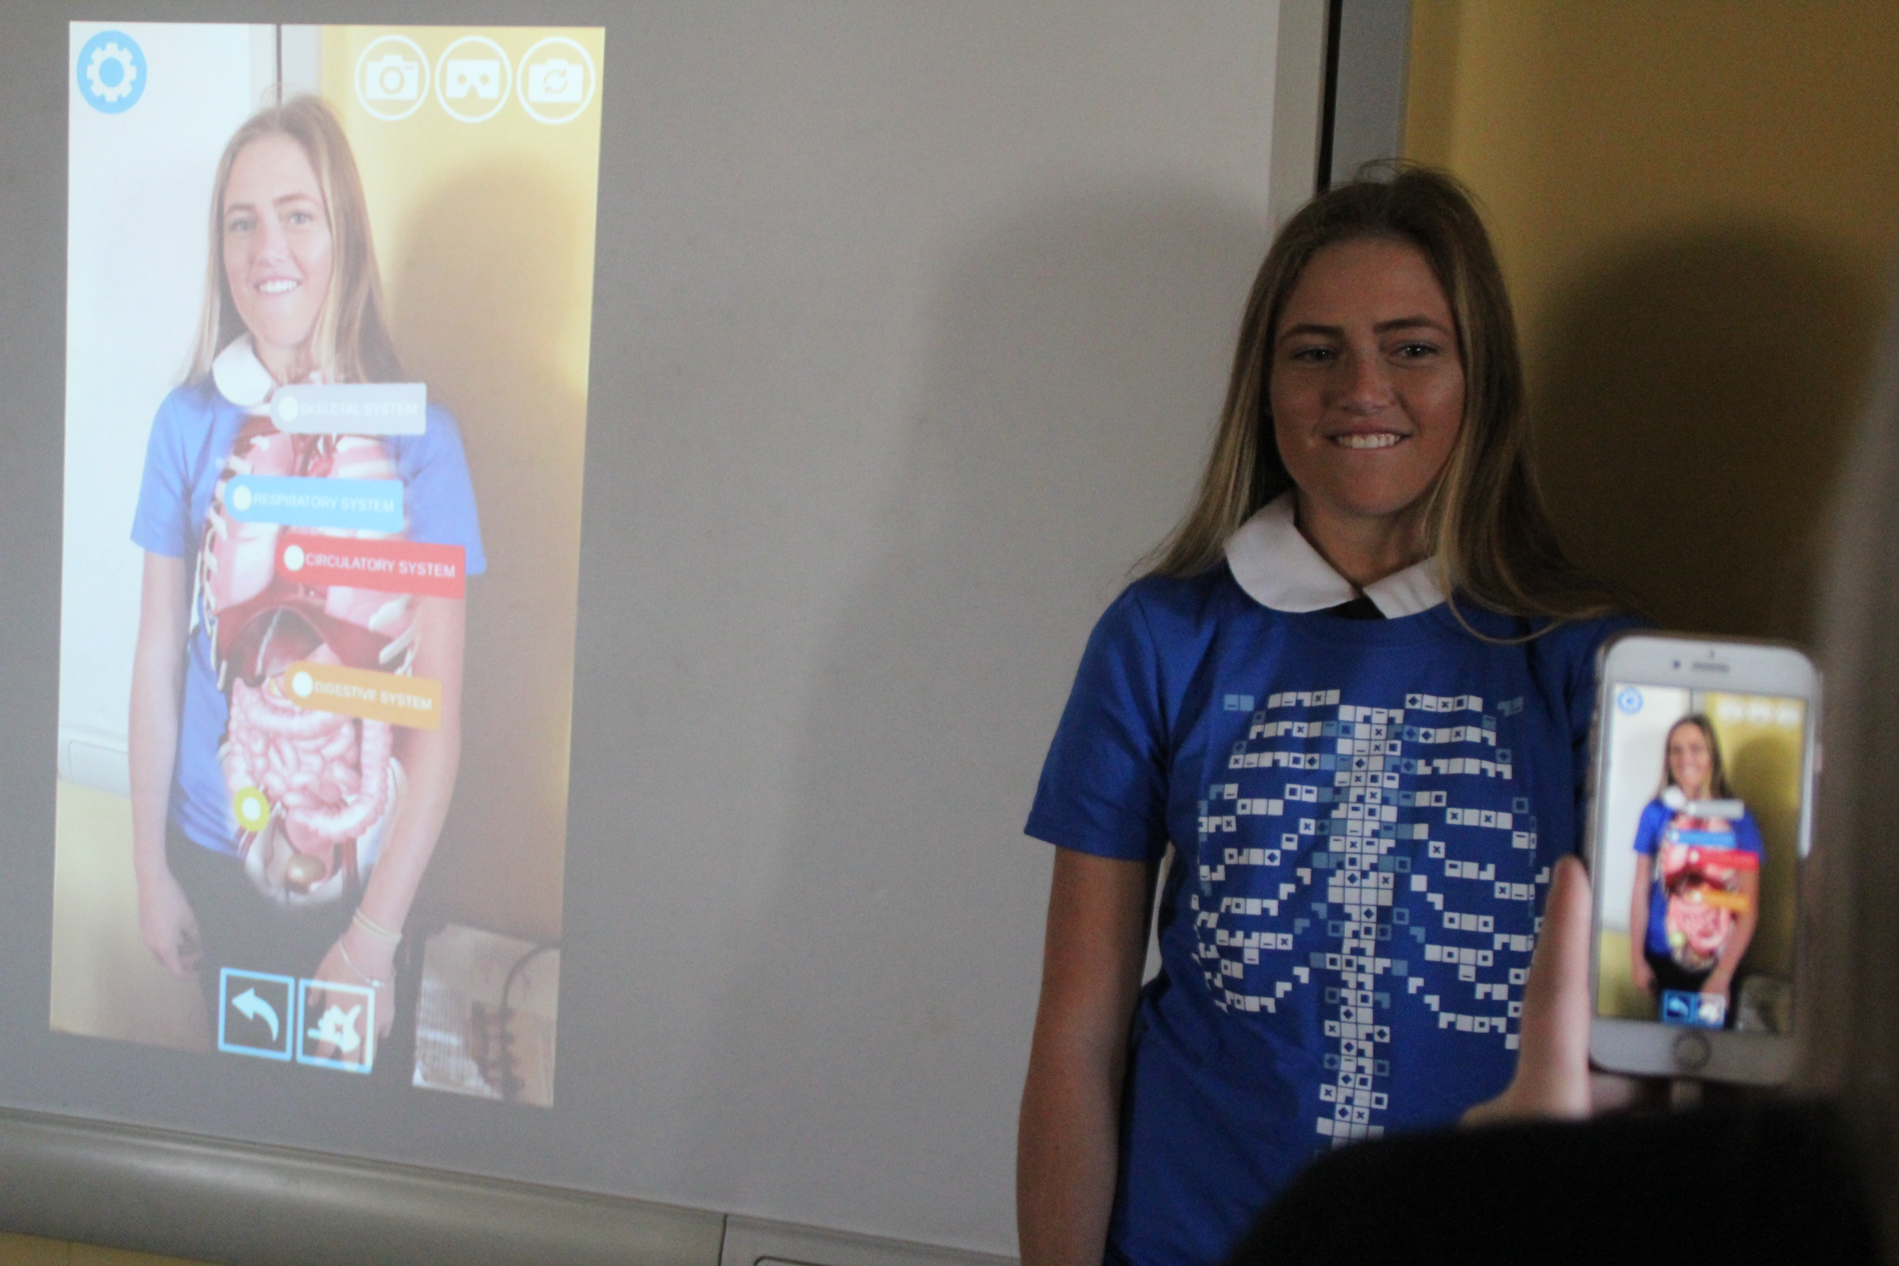
Different ways we use ICT at Orange High School

Slide 9
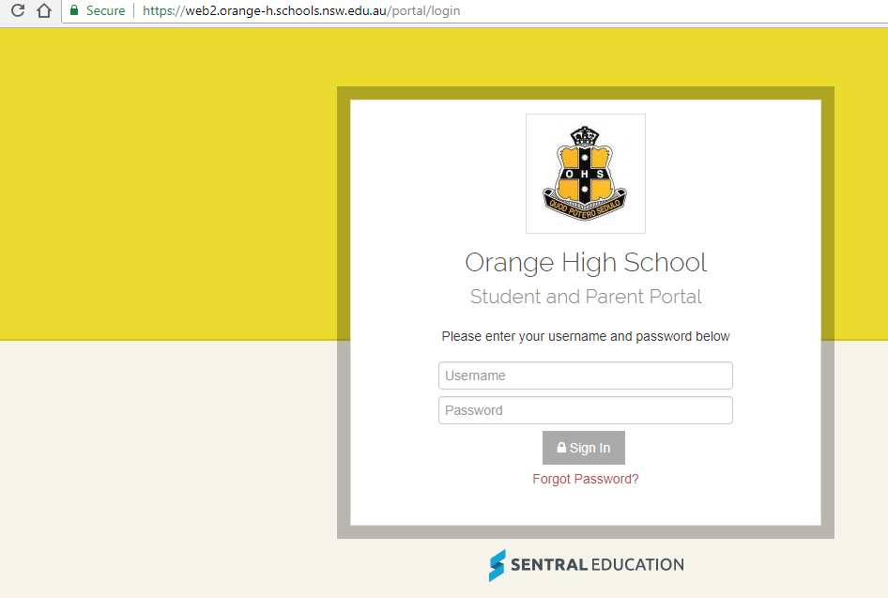
SENTRAL School
Communication Platform
Notes:
Mention: Timetables, announcements, attendance
darren.hamilton@det.nsw.edu.au password: orangehigh

Slide 10
Free on up to 5 devices
Cloud based
Accessible from any device, anytime
No need to save your work
Instantly search for thousands of files
Organisation, Collaboration, Creativity, Communication
Notes:
Jobs are becoming more
global
technology driven
flexible
and collaborative.
E.g. Jobs for app developers did not really exist until the launch of the Iphone in 2007 – now it is a thriving market.

Slide 12
Hewlett Packard OHS Deals
www.hpshopping.com.au/orangebyod
Important Information
All pricing on the BYOD devices includes 3 Years Onsite Warranty along with the option for the parent to purchase the Accidental Damage Protection (ADP).
The ADP Insurance covers the device for 3 claims over 3 years and we have moved to a Zero excess fee to assist with repairing the devices quicker and so we are not waiting for parents to pay the Excess Fee.
We’ve included an eCoupon code orange5% for purchases between now and end of the year which will give the parents an additional 5% discount.

Slide 13
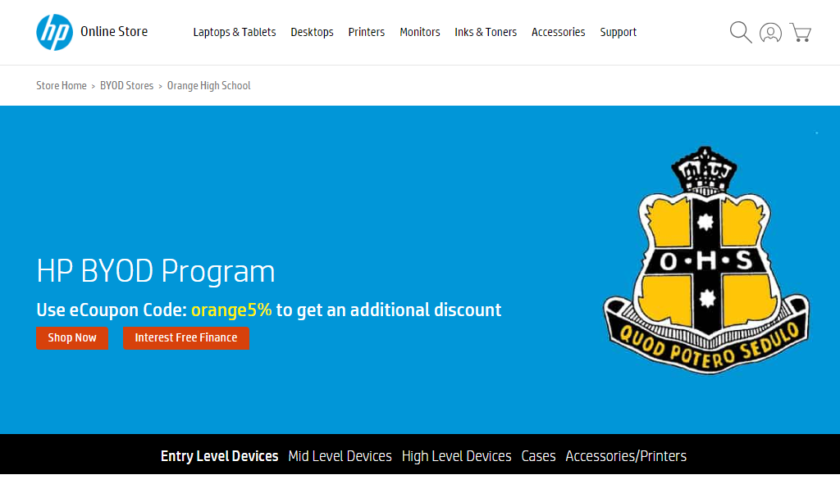
Hewlett Packard OHS Deals

Slide 14
What school support is available?
The OHS Homework Centre
Tuesday, Wednesday & Thursday
In the library 3:45 – 5pm
School teachers supporting students with homework, assessment tasks and study skills

Slide 15
What school support is available?
Technology support before, during and after school
Connectivity issues
Troubleshooting
OneNote issues
Syncing Issues

Slide 16
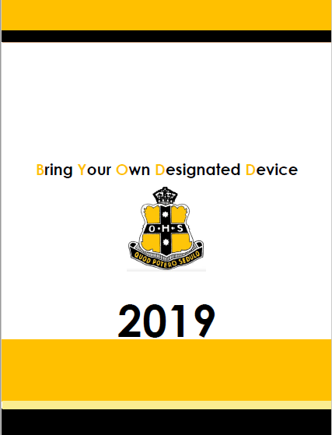
BYODD Reference Guide
This booklet is used to support students during the BYODD Bootcamp sessions at the beginning of Term1.
Copies are available on our school website, and also provided on the day for each student.
This step-by-step picture guide will support any frequent trouble shooting you may have when beginning at OHS.

Slide 17
What school support is available?
Use of the library before and after school
Large range of resources
Books, magazines, journals
Computers and internet
Free school Wi-Fi area

Slide 18
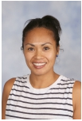
Additional - SCHOOL SUPPORT
Year 7 Year Advisor
Mrs Jacqueline Lyden
E jacquiline.lyden1@det.nsw.edu
P6362 3444
Class teachers are also available to support students.
If you need to get in touch we are also available
Deputy Principal
helene.hamilton@det.nsw.edu.au
e-Learning Coordinator
kahina.kharitos4@det.nsw.edu.au

Slide 19
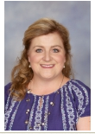
Additional - SCHOOL SUPPORT
Year 8 Advisor
Mrs Tammy Nash
E tammy.howarth@det.nsw.edu.au
P6362 3444
Class teachers are also available to support students.
If you need to get in touch we are also available
Deputy Principal
helene.hamilton@det.nsw.edu.au
e-Learning coordinator
kahina.kharitos4@det.nsw.edu.au

Slide 20
Resources
Touch typing
www.typing.com
OneNote for Students
http://www.onenoteineducation.com/en-AU/students/
Learning Tools https://www.onenote.com/learningtools
Adobe Creative Suite (Students)
http://www.adobe.com/au/creativecloud/buy/students.html
Also check out
Office Lens
http://myoffice.unsw.edu.au/introducing-office-lens
Orange High School Links
http://www.orange-h.schools.nsw.edu.au/our-school/links
Student Assessment Schedule
http://www.orange-h.schools.nsw.edu.au/online-learning
Microsoft Education Community
https://education.microsoft.com/
Notes:
Learning Tools Interactive demo

Slide 21
Survey
Thank you for attending
http://bit.ly/ohsparentbyodd2018

